Slide 1





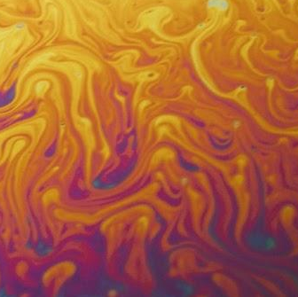
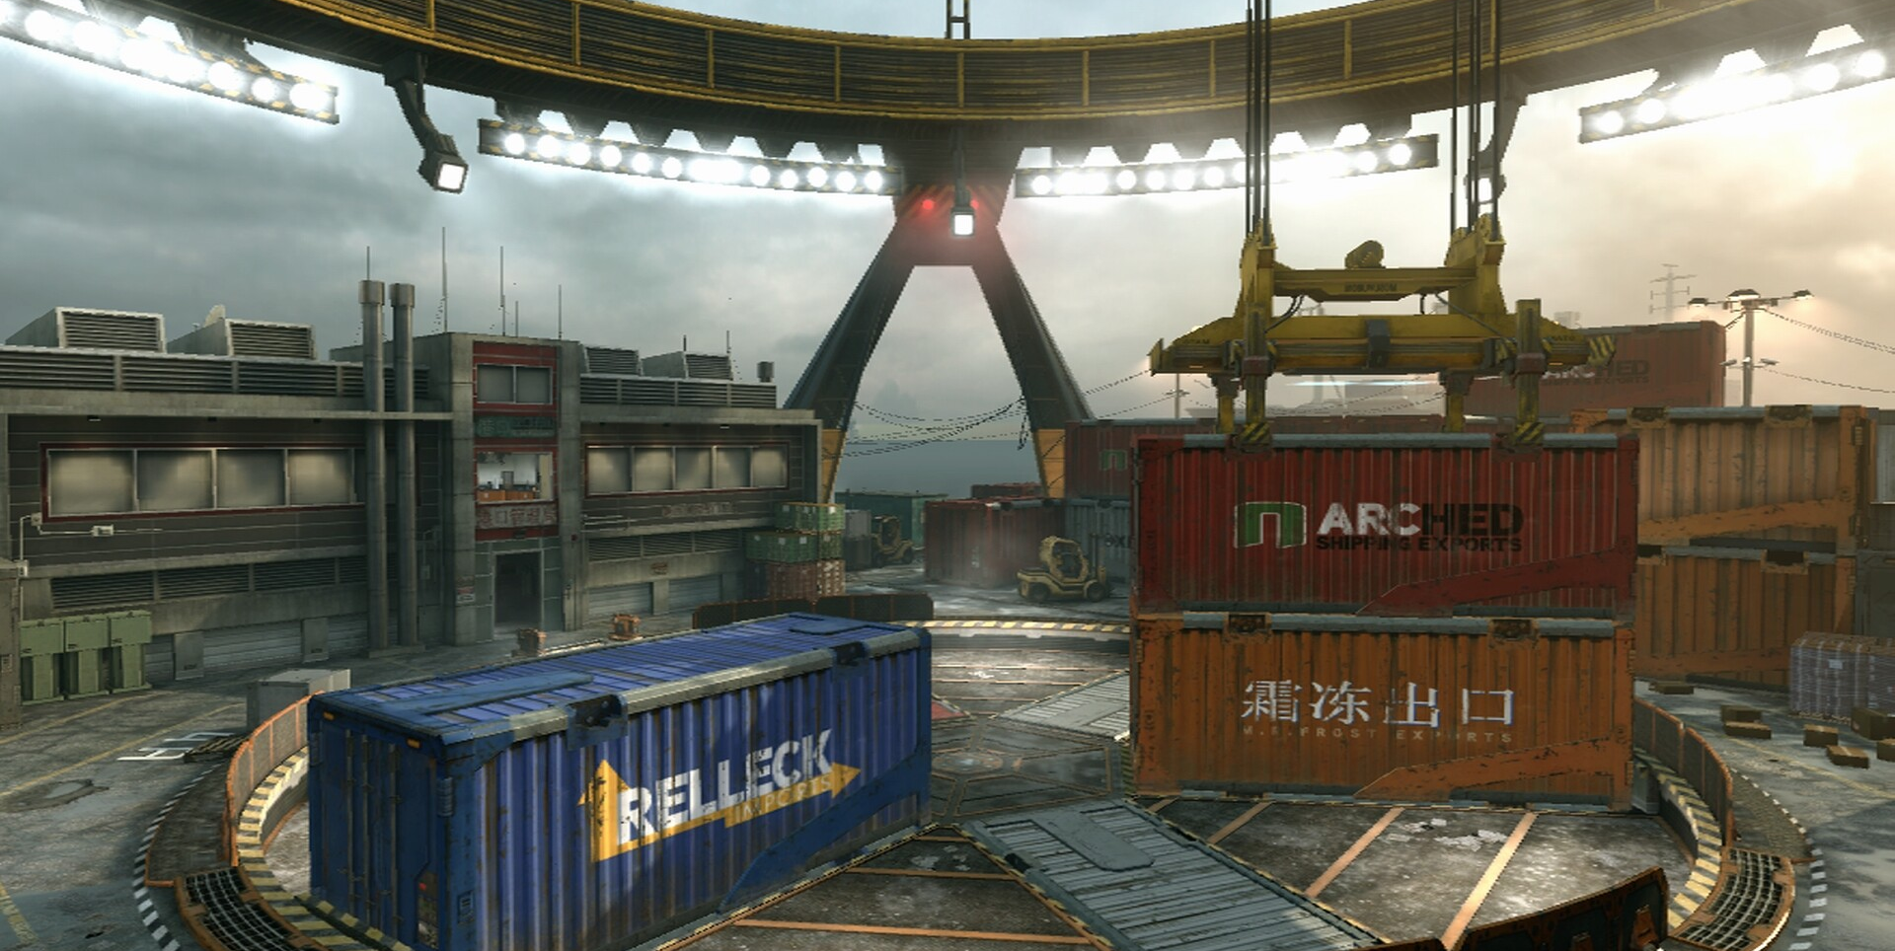

PROGRAMING
LANGUAGE
RUST
PRESENTATION
Confidential

Slide 2
AGENDA
1
OVERVIEW and APPLICATION
2
SYNTAX
3
OWNERSHIP
4
CONCURRENCY
5
MY EXPERIENCE
6
CONCLUSION
Confidential

Slide 3
OVERVIEW
AND APPLICATION
Confidential

Slide 4



Multi-paradigm, general-purpose
systems programming language.
Designed by Graydon Hoare
The goal was C/C++ performance with increased memory saftey
RUST

Slide 5
DEMO
DEMO
DEMO
DEMO
DEMO
DEMO
DEMO
1
VARIABLES
2
3
OTHER
BASICS
FUNCTIONS

Slide 6


VARIABLE TYPES
+TYPING
INTEGERS
LENGTH
UNSIGNED
SIGNED
8-BIT
i8
u8
FLOATS
16-BIT
i16
u16
f32
32-BIT
i32
u32
64-BIT
i64
u64
f64
true
false
BOOLEAN
+CHAR&STR
128-BIT
i128
u128

Slide 7


VARIABLE TYPES
+TYPING
DEFAULT
+SPECIFIED
let num = 6;
let name = “Bob”;
let num: u8 = 6;
let mut name = “Lee”;
let dec = 5.5;
IMMUTABLE
MUTABLE+
let dec: f64 = 5.5;

Slide 8

OTHER
FUNDAMENTALS
OUTPUT
IF
+ELSE
LOOPS
println!(“Hello World!”)
loop{break}
println!(“{}”, x)
if condition {}
while condition {}
else if condition {}
for item in list{}
else{}

Slide 9


FUNCTIONS
HEADER
fn test_function() {}
PASSING VARIABLES
fn test_function(x: i32) {}
RETURNING
fn test_function(x: i32) -> i32 {}
x + 7 (no ; to return)

Slide 10

P
IP
HIP
SHIP
RSHIP
ERSHIP
NERSHIP
WNERSHIP
OWNERSHIP
STRINGS
STAND
OUT

Slide 11
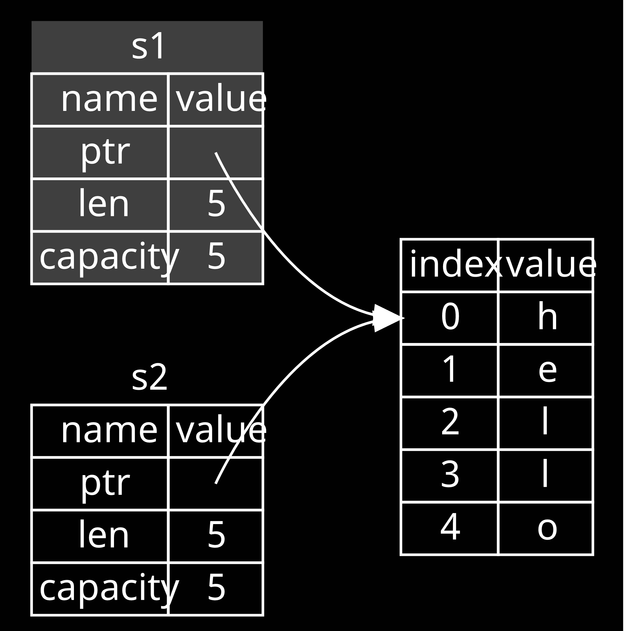
fn main() {
let s = String::from("hello");
pass_string(s);
let x = 5;
pass_integer(x);
}
MEMORY WHEN
PASSING
fn pass_string(some_string: String) {
println!("{some_string}");
}
fn pass_interger(some_integer: i32) {
println!("{some_integer}");
}
& STRING
REASSIG
-NMENT
let s1 = String::from("hello”);
let s2 = s1;

Slide 12
CONCURRENCY
fearless

Slide 13
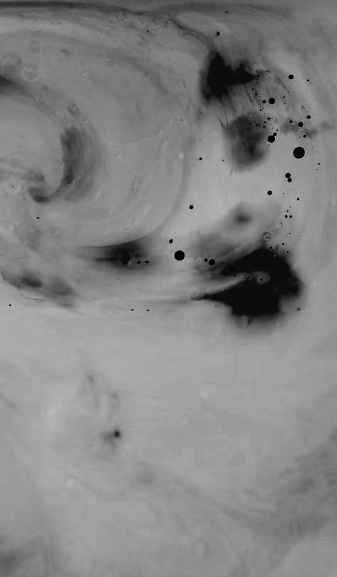
COMPILER
CATCHES
ALL
CHECKS:
Who owns data
Who can mutate data
Who can access data at the same time
ENFORCES:
Only one mutable reference at a time
Any number of immutable references, but no mutation

Slide 14


MY
EXPER-
IENCE

Slide 15



setup
Download Rust installer
Install the Visual Studio C++ Build tools
  Must be x64 MSVC toolchain
Add Rust Extension to VS Code

Slide 16
fn main() {
let mut input = String::new();
println!("Welcome to the calculator program!\n");
loop {
println!("Select from the operations below (enter the number associated):");
println!("Add: 1");
println!("Subtract: 2");
println!("Multiply: 3");
println!("Divide: 4");
println!("Exit: 0\n");
println!("Enter here: ");
let _ = io::stdin().read_line(&mut input).expect("Failed to read line");
let selection: i32 = input.trim().parse().expect("invalid input");
input.clear(); //clears out the input for the next loop
if selection == 0 {
break;
}
else {
func_select(selection);
}
}
}
fn func_select(selection: i32)
{
if selection == 1 {add();}
else if selection == 2 {subtract();}
else if selection == 3 {multiply();}
else if selection == 4 {divide();}
else {println!("Function {} does not exist. Try again.", selection);}
}
fn read_num(prompt: &str) -> f64
{
let mut input = String::new(); //input is always a string
println!("{}", prompt);
io::stdin().read_line(&mut input).expect("Failed to read line");
input.trim().parse().expect("invalid input")
}
fn add() {
let (num1, num2) = enter_num();
println!("\n{}+{}={}\n", num1, num2, num1 + num2);
}
fn subtract() {
let (num1, num2) = enter_num();
println!("\n{}-{}={}\n", num1, num2, num1 - num2);
}
fn enter_num() -> (f64, f64)
{
(read_num("Enter number 1:"), read_num("Enter number 2:"))
}
fn multiply() {
let (num1, num2) = enter_num();
println!("\n{}*{}={}\n", num1, num2, num1 * num2);
}
fn divide() {
let (num1, num2) = enter_num();
println!("\n{}/{}={}\n", num1, num2, num1 / num2);
}

Slide 17

fn main() {
let arr1 = vec![vec![1, 1, 1], vec![0, 0, 0], vec![1, 1, 1]];
let arr2 = vec![vec![1, 1, 1, 1], vec![1, 1, 1, 1], vec![0, 0, 0, 0], vec![0, 0, 0, 0]];
let arr3 = vec![vec![0, 0], vec![0, 0]];
find_zrow(3, &arr1);
find_zrow(4, &arr2);
find_zrow(2, &arr3);
}
fn find_zrow(n: i32, x: &Vec<Vec<i32>>) {
for i in 0..n {
for j in 0..n {
if x[i as usize][j as usize] != 0 {
break;
}
if j == (n-1) {
println!("The first non-zero row is {}", (i + 1));
return;
}
}
}
}

Slide 18
CONCLUSION
CONCLUSIO
CONCLUSI
CONCLUS
CONCLU
CONCLU
CONCL
CONC
CON
CO
C

Slide 19
THANK
YOU!

